Slide 1
(Intro to) Sysmon Deep Dive
Walking through an initial compromise with sysmon
By @dustymmiller

Slide 2
What is Sysmon
Sysmon is a free tool designed to extend the current logging capabilities in Windows to aid in understanding and detecting attackers by behavior.
For ease of collecting the logs, all of the events generated are saved in Microsoft-Windows-Sysmon/Operational EventLog, which allows current security products that already leverage collection from the EventLog in Windows.
Sysmon is able to monitor for a series of actions on a Windows host that relate to existing behavior that is abused by threat actors. With this view on the actions, defenders are able to better detect abnormal behavior and abuses on a system.
(TrustedSec Community Guide)

Slide 3
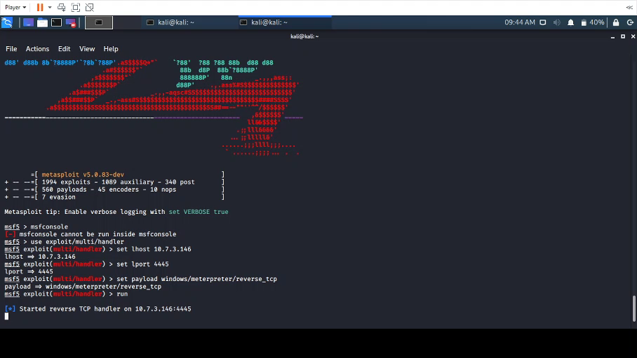
The compromise!
Meterpreter Reverse Shell hidden in malicious word document (.docm)
Meterpreter to get system privilege, migrate into different process, and dump hashes.

Slide 4
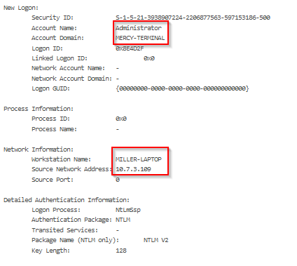
Logon events Event Id 4624
The computer in question is named Mercy-Terminal and the IP is 10.10.1.6
Administrator Login
Source IP and Workstation Name
Workstation Name often doesn’t show

Slide 5
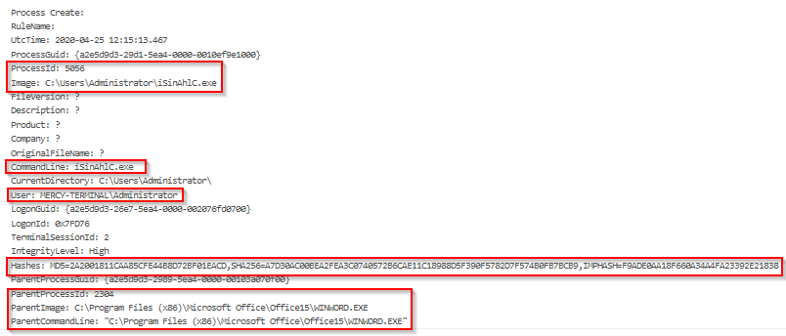
process creation Event ID 1

Slide 6
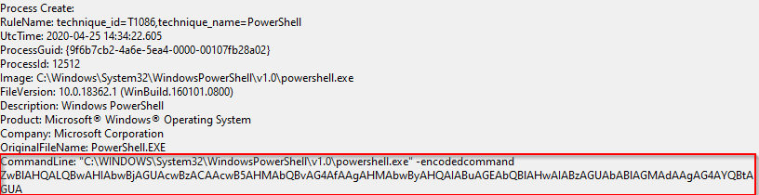
Process creation
Process ID and Image are important to note for future logs
Command line can often show what flags were used opening a program
Hashes can be compared to sites like VirusTotal.com
Parent information can be important

Slide 7
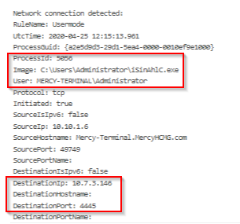
Network Connections Event ID 3
Outbound network connection from ProcessID and Image created earlier
Destination IP can also be checked against VirusTotal.com, but may not show if it is a newer C2 (Command and Control Server)

Slide 8
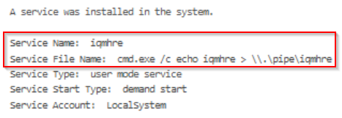
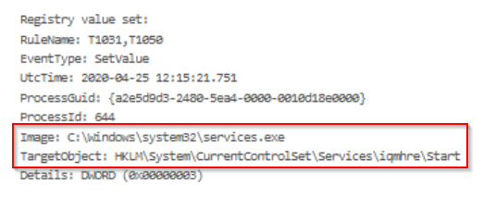
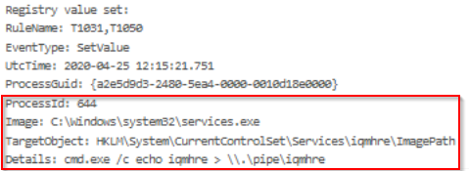
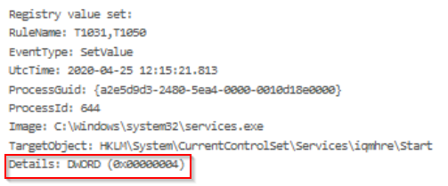
Escalation Event id 13

Slide 9
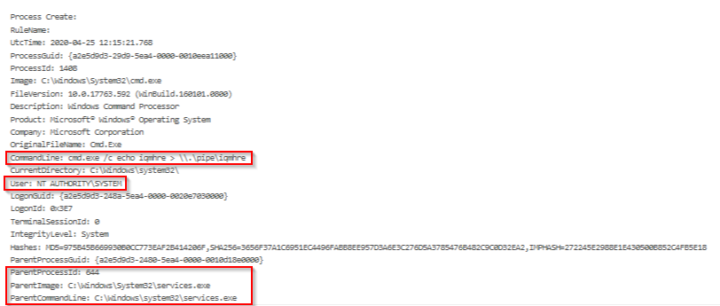
Escalation

Slide 10
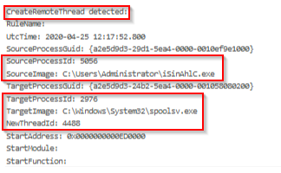
Pivot Event ID 8
CreateRemoteThread is a way a process can inject itself into another process
We see our process from earlier inject itself into the spool process

Slide 11
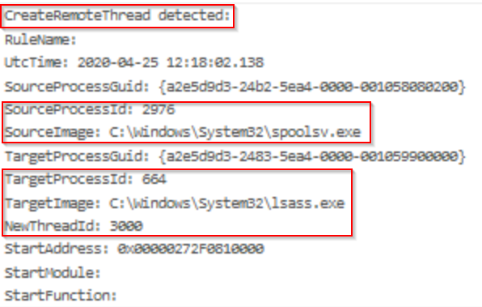
Exploit Event ID 8
Another CreateRemoteThread Event
Using the ProcessID and Image that our initial process injected itself into.
Accessing lsass.exe (major red flag)
Local Security Authority verifies users logging on to a Windows computer or server, handles password changes, and creates access tokens.

Slide 12
Resources Any questions?
Sysmon - https://docs.microsoft.com/en-us/sysinternals/downloads/sysmon
Community guide - https://github.com/trustedsec/SysmonCommunityGuide
Olaf Hartong - https://github.com/olafhartong/sysmon-modular
Swiftonsecurity - https://github.com/SwiftOnSecurity/sysmon-config
https://securityintelligence.com/identifying-named-pipe-impersonation-and-other-malicious-privilege-escalation-techniques/
Find me at @dustymmiller on twitter

